Slide 1
Summary-based Static Program Analysis
Shuangxiang Kan,
Program Analysis Group
University of Technology Sydney (UTS)
01/04/2022
Notes:
The research project I am focus on now is static program analysis. It is an area that can analyze the program without need to run the program.

Slide 2
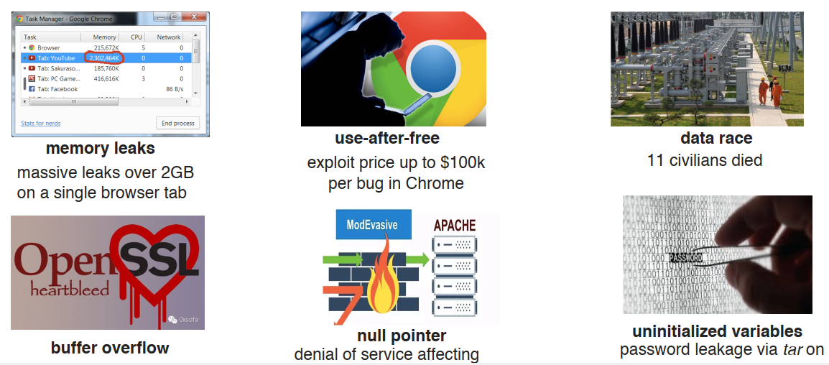
Modern System Software Extremely large and complex but error-prone
Notes:
Nowdays, the scale of modern system software is becoming extremely large and complex, With such a large scale of software, problems with the software are inevitable. These software bugs can usually cause very large economic and social losses.

Slide 3
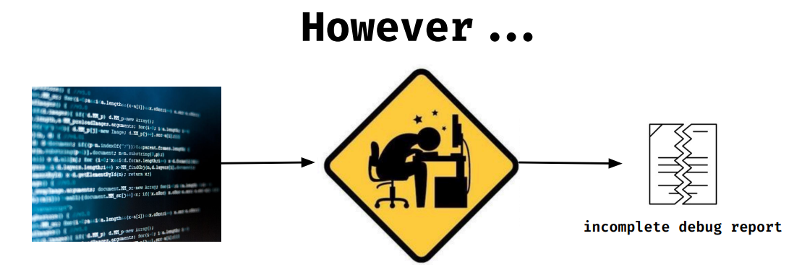
Review by Developers
A large project (e.g., consists of millions of lines of code) is almost impossible to be manually checked by human :
-- intractable due to potentially unbounded number of paths that must be analyze
-- undecidable in the presence of dynamically allocated memory and recursive data structures
Notes:
A good way to avoid software problems is to check the program to find possible bugs before the software is released. But this approach often does not work in real practice. Because a large project (e.g., consists of millions of lines of code) is almost impossible to be manually checked by human :
The first reason is that software defects is intractable due to potentially unbounded number of paths that must be analyze
Another reason is that program bugs are undecidable in the presence of dynamically allocated memory and recursive data structures

Slide 4
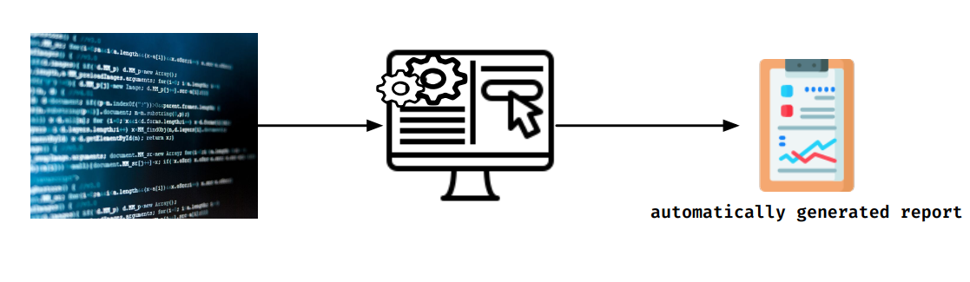
What is Software/Program Analysis
Software Analysis a.k.a Program analysis is the process of automatically analyzing the behavior of computer programs such as correctness, robustness, safety and security.
Program analysis is to develop algorithms and tools which can analyze other programs
Notes:
So computer scientists come up with a idea that if they can develop algorithms and tools to automatically analyze the behavior of computer program such as correctness, robustness, safety and security..

Slide 5
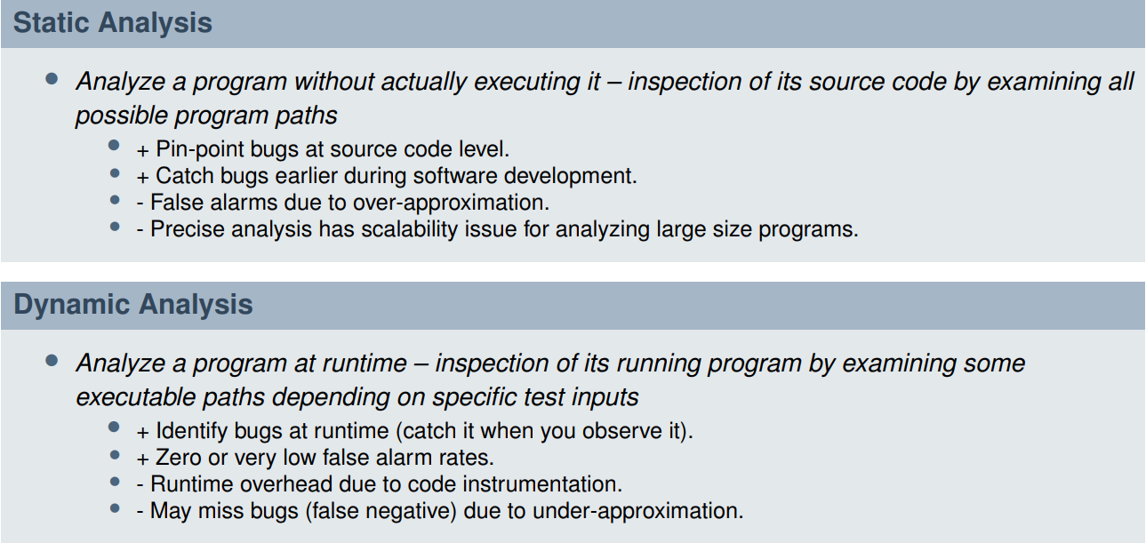
Static Analysis vs. Dynamic Analysis
Notes:
There are two different ways to analyze the behavior of the software, static analysis and dynamic analysis.
Static analysis is that …
And Dynamic Analysis is to …
Static analysis is the focus of my research project.

Slide 6
Limitaion
Static program analysis can examine all possible program paths, however, if implemented as a whole-program analysis (WPA) for a large program, is notorious for causing problems with scalability in
Memory consumption.
Runtime
Notes:
Although static program analysis is a good way to detect program bugs, but it still has a lot of limitation, one of the limiations is scalability.
That is, it’s hard for static program to perform on large program, Because the memory consumption required for larger programs can easily grow to a large two-digit GB figure , And analysis times can amount to several hours. So it is often not practical to conduct whole program analysis for a large program.

Slide 7
Solutions
To accelerate whole-program analysis, a useful approach is making the analysis modular and compositional. The practicability of this compositional program analysis is that software has a large part of libraries, and these libraries
Make up, on average, more than 50% of the the whole program code
Updated much less frequently than application code
Summarize Them
Notes:
In order to accelerate a larger program analysis, we can make the analysis modular and compositional. The practicability of this compositional program analysis is because that ***
Libraries in the program usually make up, on average, more than 50% of the the whole program code, In addition, ***
Library code are updated much less frequently than application code.
So we can pre-compute those stable library information as summary, ***and combine them with application code to accelerate the process of whole-program analysis.

Slide 8
Design and Implementation
library1
Static Program Analyzer
Pre-computed summaries
library2
result
library3
application
Notes:
That’s the overview of my design.
We can compute the summary information of three libraries in advance, because these libraries code are stable,
Then we can combine these summarys with application code to do static program analysis to get the result we want.
Many experiments result has show it’s a very effective way to speed up the analysis of large program.

Slide 9
Thanks
Notes:
That's all I'm going to talk about today, thank you.

